Slide 1
Whole Setting Safeguarding Update
September 2024

Slide 2
Before we start…
Do look after yourself.
Notes:
[Presenter note: Do share relevant venue and safety information. It’s also important to remind everyone attending that this training contains topics / materials / videos / content that some people might find upsetting.]
Welcome to this safeguarding update. Before we start it is important to remember that discussing safeguarding children and child abuse can be distressing, and these feelings are ok. Please make sure you and your staff look after yourselves, and each other, and get support where you need it, including from the DSLs and Deputies. It is, however, a crucial part of our work with students. Briefly leave the session if you need to, to take a breather.
Take a moment to think about where you can get support and supervision in our setting… from one another, from SLT and from our safeguarding deputies and lead. [You may want to remind people of any changes, contact arrangements, etc.]
As we move through this presentation, we will be thinking about safeguarding children in general. However, some groups of children are additionally vulnerable and at increased risk of experiencing harm and abuse. We know from the research that disabled children and children with SEND are at increased risk of abuse and also less likely to receive protection when they experience abuse (Jones et al, 2012 and Taylor et al, 2014). There are many reasons for this which include perceptions of disability, communication difficulties, and how signs and indicators can be misattributed to a diagnosed condition and therefore explained away.
[Again, you can take a moment to discuss which groups might be more vulnerable in your setting and highlight any work going on around these. We recommend that settings which support children with complex needs and disabilities receive appropriate training to unpick some of these issues more thoroughly. Safeguarding Network offers external supervision which is hugely valuable in reflective practice for safeguarding, especially where there are complex needs.]
The latest statistics from The National Child Mortality Database 2023: There were 160 deaths of children and young people due to violence or maltreatment during the 3 years 2020 - 23; 35 (22%) were infants under 1, 28 (18%) were aged 1-4 years, 27 (17%) were aged 5-14 years, and 70 (44%) were aged 15-17 years. When adjusting for the number of children in the population, children under 1 had a risk of death over 5 times greater than the average.
This is usually someone who is a care giver, parent, step-parent. Whereas the reasons for the increased vulnerability for younger children might appear obvious (due to mobility, no communication, not seen by agencies regularly, etc) the reasons for increased vulnerability of a second age group might not appear so.
[At this point you can ask the participants to guess which age group is the second most at risk after those under 1 year old.]
The second most at risk age group is 16-24 years (ONS, appendix tables homicide). This is largely due to contextual risks, that is risks that exist outside of the family home. The risk older teenagers pose to themselves and each other along with the common misconception that as teenagers, they are more capable of looking after themselves. It is possible to divert our attention away from teenagers and view them as young adults and this means that we can sometimes unintentionally view older children as being to blame for some of the risks they are experiencing especially where there are concerns about contextual risks. It is however important to remember the definition of a child is anyone under the age of 18 years old. As we move through this training it is important to keep these points in mind.

Slide 3
Aims of this training
1
Understand what safeguarding is and your responsibility to fulfil your safeguarding responsibility
2
Be familiar with the key messages in the guidance and legislation
Know types of abuse, how to spot the signs and indicators , and how to respond
Understand how to report concerns about professional adults
5
Know how to receive a disclosure and record safeguarding concerns effectively
4
3
Notes:
[This training is designed to provide a general overview, reminder and update of safeguarding knowledge. Whilst updates are important, it is a strong safeguarding culture that will support this training. Such cultures develop through regular, ongoing updates throughout the year which, as identified in Keeping Children Safe in Education will enable knowledge to be deepened on specific safeguarding issues. Therefore, it is important that all settings recognise this as an overview only and continue to engage with the rest of Safeguarding Network’s materials over the course of the 2-year staff training calendar. We also note and emphasise the statutory responsibility of ensuring ALL staff have read and understood at least part one of Keeping Children Safe in Education (or Annex A where appropriate and agreed). We provide support with this through our membership materials and offer a knowledge checker to be able to evidence and consolidate learning from reading the guidance and through attending this training. We would advise that after completing this training, all staff complete the knowledge checker, which can be allocated by the organisation’s DSL in the manage e-learning tab in the members area.]
This training will cover the five key areas shown. Its aim is to provide a basic overview and for many of you a refresher. By its very nature there will be things that you have covered before, however it is important that we revisit these regularly to ensure that your knowledge remains fresh and up to date.

Slide 4
Aims of this training
1
Understand what safeguarding is and your responsibility to fulfil your safeguarding responsibility
2
Be familiar with the key messages in the guidance and legislation
Know types of abuse, how to spot the signs and indicators , and how to respond
Understand how to report concerns about professional adults
5
Know how to receive a disclosure and record safeguarding concerns effectively
4
3
Notes:
We will therefore start by looking at what safeguarding is and what your responsibilities are.

Slide 5
What is safeguarding?
1
Notes:
Group exercise – get participants into groups and ask them to answer this question.
Answers should include things like: listening to children, noticing changes, following policies, behaviour, staff code of conduct, relationships, site security, visitor sign in systems, risk assessments, DBS/Safer recruitment checks, reporting concerns, attending meetings, making referrals to agencies, training, preventative curriculum, filtering and monitoring systems, challenging poor practice etc.
The main message is that safeguarding is everything we do, all of the time, to ensure all the children and young people we work with have the best outcomes. It is preventative as well as reactive and applies to everything that we do for all children. Child protection is the part of safeguarding which is necessary when there is suspicion/evidence of a child being abused.

Slide 6
What is safeguarding?
1
Safeguarding and promoting the welfare of children is defined for the purposes of this guidance as:
providing help and support to meet the needs of children as soon as problems emerge;
protecting children from maltreatment, whether that is within or outside the home, including online;
preventing the impairment of children’s mental and physical health or development;
ensuring that children grow up in circumstances consistent with the provision of safe and effective care;
taking action to enable all children to have the best outcomes.
Keeping Children Safe in Education 2024
Notes:
Keeping Children Safe in Education provides this definition of safeguarding. We need to be aware that this has been updated in the last year, with the highlighted sections being the parts that have been added. The reason for the additions are to reinforce the role of early help in safeguarding and to also emphasise that abuse can happen inside and outside the home (with this not only being in the “real” world, but also the online the world.
So the question is how we work as a setting to ensure that we are implementing this definition of safeguarding – do we think that we are good at all these aspects? Do we identify when children and young people need help, do we work to ensure that they know about what it means to be safe, how to flag up concerns, do we listen to them when they tell us what is happening to them and work to ensure that they get the best possible outcome?
This is not necessarily something that we can do by ourselves, but we need to make sure that we do what we can. Keeping Children Safe in Education 2024 reminds us that “No single practitioner can have a full picture of a child’s needs and circumstances. If children and families are to receive the right help at the right time, everyone who comes into contact with them has a role to play in identifying concerns, sharing information and taking prompt action.”

Slide 7
1
This must never be allowed to happen again…
1880’s Child cruelty
1948 Children Act
1975 Children Act
1988 Cleveland
1990 UN Rights of the Child
2002 Holly Wells and Jessica Chapman
2008 Baby P
2015 FGM reporting
2021 Ofsted review Sexual Abuse in schools
2022 Review into strip search of Child Q on school premises
2022/23 Safeguarding children with disabilities in residentials settings
1945 Dennis O’Neill
1973 Maria Colwell
1984 Jasmine Beckford
1989 Children Act
2000 Victoria Climbie
2006 Vetting checks
2013 Rochdale CSE
2020 Star Hobson and Arthur Labinio Hughes
2022 Review into deaths of Star Hobson and Arthur Labinio Hughes
2023 Working Together updated
2024 CASS report
Notes:
[Presenter note: We have included notes below for your information and/or in case you are asked questions. It is not expected that you would go through everything as this would be too time consuming – a brief summary would suffice. The aim of including the timeline is to demonstrate the way in which safeguarding and child protection has and continues to be shaped and developed.]
So how have we arrived at this point? There is a lengthy history of safeguarding and child protection which has been established and amended in response to the tragic and violent deaths of many children, too many children to mention. Despite the first ever review into child abuse in 1945 concluding this should never be allowed to happen again, it has, many times, and there have been further incidents where vows have been made to stop abuse happening. We are still learning, and this is why it is imperative that we all know and understand the importance of safeguarding, and our role within its wider remit. We are all parts of the jigsaw, and in order for the jigsaw to fit together we all need to know our role. As agencies we work very hard to keep a large number of children safe from harm, and we often do this. However, we also know, as you can see from many of the key points on this timeline, that there are occasions when things have gone very badly wrong.
So, where are we now? Abuse and neglect is a complex area and our understanding is ever evolving and there is therefore a need to keep learning. There are regular reports, reviews and inquiries which are shaping our understanding, but we are not there yet. History informs our current work, but a lot of it is still relatively recent, for example the implementation of vetting checks and the introduction of the role of the LADO only occurred in 2006. This reinforces the point about the need for ongoing learning and regular updates. A commitment to our professional development is not something required for inspections, it is something required so we can be in the best position to safeguard children.
Timeline:
In the 1880’s child cruelty was first identified as a concept.
1945 saw the first child abuse inquiry following the death of Dennis O’Neill. Dennis died whilst in foster care, showing signs of having been beaten and neglected. The independent review effectively established the need for accountability, oversight, information sharing between agencies and a focus on child-centred practice, many of which are themes which are still prevalent in reviews being undertaken currently.
Children Act 1948 – this was the first time the local authority had duty to accommodate children if parents could no longer care for them, and it was in their best interests.
In 1973, Maria Colwell was killed by her stepfather after being returned home from foster care. Her mother kept her up as stepfather was in the pub. On his return he killed her. Her death led to the establishment of the child protection system, with local review and press articles concluding this must never be allowed to happen again.
Children Act 1975 highlighted children’s welfare and set up the role of independent social worker for court (now CAFCASS).
The death of Jasmine Beckford in 1984 as a result of cruelty, beatings and starvation bought further changes. The author of an inquiry into her death in 1985 delivered professionals and ultimatum – “Thou shalt not not intervene”. The inquiry determined that children are our clients, not their parents. This sparked a debate during the mid-80’s over child and parent’s rights.
In 1988 another inquiry following the allegations of sexual abuse in Cleveland led Tony Newton, the then Health Minister, to state that proper action to protect children would not be allowed to "trample on the rights of parents".
The Children Act 1989 gave rise to a problem – the act was clear that children’s welfare is paramount, and it is within this context that courts should make decisions, however the principle of paramouncy was counter to a previous directive to not trample on the rights of parents. The impact was that social workers could no longer act independently to remove a child, this instead requiring a decision by a court or use of police powers of protection.
1990 – UN Rights of the child determined that child was an individual with their own unique set of rights.
The death of Victoria Climbié in 2000 led to further reform of the child protection system following an inquiry by Lord Laming. Another death in 2000, that of Lauren Wright (killed by stepmother who was member of school staff), led to the formal requirement for a designated safeguarding lead in all education settings.
Further changes, this time in relation to recruitment practices and managing allegations were bought in following the death in 2002 of Holly Wells and Jessica Chapman. The review found that amongst other concerns, their killer, Ian Huntley, had previously been investigated for rape. This led to recommendation of appropriate vetting taking place before anyone was able to start working with children.
In 2006 a piece of legislation, the Safeguarding Vulnerable Groups Act was given royal assent. This established the requirement for vetting checks and also established the role of Local Authority Designated Officer – the aim of the role being to collate information about allegations against professionals and support schools and other settings to properly investigate concerns.
2008 saw the death of Baby P with the now infamous statements by the then Children’s Secretary, Ed Balls that the tragedy will never be repeated. These statements were deemed irresponsible by council chiefs.
In 2011 the government commissioned Munro Report into child protection as part of a “national drive to improve the quality of child protection services” due to the concern that “the child protection system in this country become rather more about protecting the system than about protecting the children whom the professionals went into their professions to protect” (this position being stated by Tim Loughton the Under-Secretary of State for Education at the time). The report made a number of sweeping recommendations for change.
2013 saw the publication of the review into the sexual abuse / sexual exploitation that took place in Rochdale. One area of focus was the concern that there was little challenge and a failure to act by professionals due to a fear of being called racist.
In 2015 mandatory reporting was introduced where health and social care professionals and teachers in England Wales know of cases of female genital mutilation.
In 2020 we saw the deaths of Star Hobson and Arthur Labinjo-Hughes. This led to national inquiries which reported in 2022.
In 2021 we had the damning Ofsted review into sexual abuse in schools and colleges. This found that there were a number of issues that needed addressing, with Keeping Children Safe being amended to reflect these.
2022 saw the review into Child Q, a Black female secondary school aged child, who, in 2020, was strip searched by police on school premises without an Appropriate Adult present and without effective challenge from school staff. Concerns were also raised about the ‘adultification’ of black children and its impact in this situation.
In 2022 and 2023, phases 1 and 2 of the Hesley report into safeguarding children with disabilities and complex health needs living in residential settings. The phase 1 report examines allegations of abuse and neglect to children living in three private residential settings operated by the Hesley Group, which found that insufficient safeguarding measures were in place to ensure the safety and wellbeing of the children, and as a result, the children had been exposed to serious harm and ongoing risk. There was also there is criticism of the role of the LADO. The phase 2 report sets out recommendations to improve the safety, support and outcomes for children with disabilities and complex health needs living in residential settings which include: that all children with disabilities and complex health needs should have access to independently commissioned, non-instructed advocacy from specialist trained advocates, ensuring that practitioners understand the requirements for legally compliant practice in relation to Deprivation of Liberty Safeguards and that guidance about the inherent risks from ‘closed cultures’ should be included in ‘Working Together to Safeguard Children’ and ‘Keeping Children Safe in Education’.
In 2024, Dr Hilary Cass submitted her final report and recommendations to NHS England in her role as Chair of the Independent Review of gender identity services for children and young people. The Review was commissioned by NHS England to make recommendations on how to improve NHS gender identity services, and ensure that children and young people who are questioning their gender identity or experiencing gender dysphoria receive a high standard of care, that meets their needs, is safe, holistic and effective. The report describes what is known about the young people who are seeking NHS support around their gender identity and sets out the recommended clinical approach to care and support they should expect, the interventions that should be available, and how services should be organised across the country. It also makes recommendations on the quality improvement and research infrastructure required to ensure that the evidence base underpinning care is strengthened. In making her recommendations, Dr Cass has had to rely on the currently available evidence and think about how the NHS can respond safely, effectively, and compassionately, leaving some issues for wider societal debate.

Slide 8
What is abuse?
1
… a form of maltreatment of a child. Somebody may abuse or neglect a child by inflicting harm or by failing to act to prevent harm. Harm can include ill treatment that is not physical as well as the impact of witnessing ill treatment of others. This can be particularly relevant, for example, in relation to the impact on children of all forms of domestic abuse, including where they see, hear or experience its effects. Children may be abused in a family or in an institutional or community setting by those known to them or, more rarely, by others. Abuse can take place wholly online, or technology may be used to facilitate offline abuse. Children may be abused by an adult or adults or by another child or children.
Notes:
This is the current definition of abuse in both Keeping Children Safe in Education and Working Together, which has been updated in the last year.
As you can see, abuse can cover many situations, including direct acts (where the abuse is targeted at a person) and indirect acts (where an act causes harm, but that was not the intention of the act). We can also see here that abuse is not just in the family, or in our setting, but can also happen in community settings, with individual's online persona’s being equally vulnerable to abuse and harm as well as their real-life persona.
Therefore, the key message is that if we see or hear something that concerns us, we need to ensure that we follow this up.

Slide 9
1
Neighbourhood
& wider
School /
College
Safeguarding in context
Peer
Group
F
Family /
Home
Child / Young Person
Notes:
The reason for the emphasis on abuse not only happening in the home is that as individuals we are influenced by a number of different factors, and the children and young people that you see on a daily basis are the same. Each child or young person is a member of a family (whether a formal group or an informal collaboration), have a peer group to a greater or lesser extent, are a member of our setting and then also part of (integrated into or not) the neighbourhood in which they live. The child or young person that you therefore see before you is the product of an infinite number of interactions, some memorable for them, others seemingly insignificant, but these all act to shape what is happening for the child on a daily basis and how they will respond.
It is this that we need to remember when thinking about how to safeguard children and young people in our care. We should always ask ourselves, “what else do we know about this child / young person?” As an example, we could consider domestic abuse and attitudes towards others in intimate relationships. In our setting we focus on values which include the need for personal space, kindness to others and consideration of others wishes and feelings. However, the child may witness domestic abuse in their own home which may lead them to think that abuse is the only way to get what you want from another in a relationship, their peer group may have a hierarchical structure to it (particularly if their group is based around gang membership) which may again influence how they view the roles of others who they view as higher than, equal to or lower in the pecking order than themselves. The peer group may also have views on members of the opposite sex, which then influence how they behave. The wider neighbourhood will also then act to influence how the young person sees themselves – do they have a sense of belonging or do they want to do everything they can to leave? Therefore, whilst our setting is aiming to steer them down a particular path, there are a lot of other influences.

Slide 10
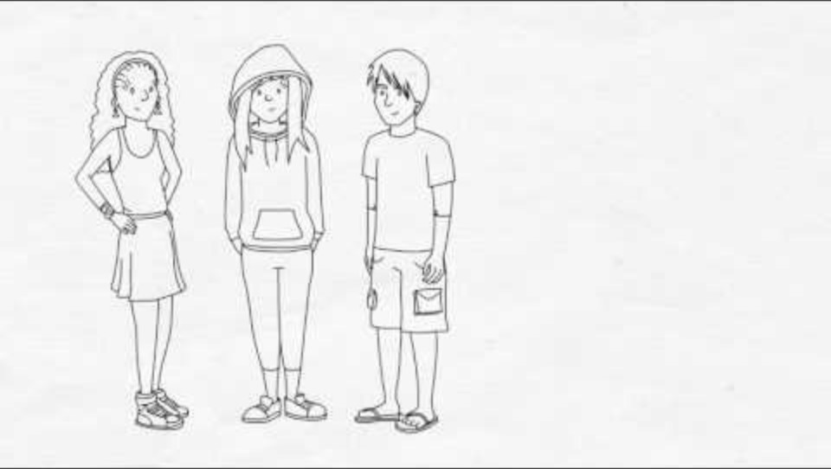
What is contextual safeguarding?
1
Notes:
https://youtu.be/V0lE-XENewM?si=lSAQXU4HwaM8ZQgv
This video builds on what we have just talked about.

Slide 11
Categories of abuse
1
"Child abuse is when a child is harmed by an adult or another child – it can be over a period of time but can also be a one-off action. It can be physical, sexual or emotional and it can happen in person or online. It can also be a lack of love, care and attention – this is neglect."
NSPCC
Notes:
Guidance identifies four categories of abuse. The NSPCC provide this shortened definition which encapsulates these four categories. The categories are as follows:
Physical abuse: a form of abuse which may involve hitting, shaking, throwing, poisoning, burning or scalding, drowning, suffocating or otherwise causing physical harm to a child. Physical harm may also be caused when a parent or carer fabricates the symptoms of, or deliberately induces, illness in a child.
Emotional abuse: the persistent emotional maltreatment of a child such as to cause severe and adverse effects on the child’s emotional development. It may involve conveying to a child that they are worthless or unloved, inadequate, or valued only insofar as they meet the needs of another person. It may include not giving the child opportunities to express their views, deliberately silencing them or ‘making fun’ of what they say or how they communicate. It may feature age or developmentally inappropriate expectations being imposed on children. These may include interactions that are beyond a child’s developmental capability as well as overprotection and limitation of exploration and learning or preventing the child from participating in normal social interaction. It may involve seeing or hearing the ill treatment of another. It may involve serious bullying (including cyberbullying), causing children frequently to feel frightened or in danger, or the exploitation or corruption of children. Some level of emotional abuse is involved in all types of maltreatment of a child, although it may occur alone.. The key word in this description is persistent – a one-off incident may not cause long term harm, but the cumulative effect of the abuse may lead to significant harm taking place.
Sexual abuse: involves forcing or enticing a child or young person to take part in sexual activities, not necessarily involving violence, whether or not the child is aware of what is happening. The activities may involve physical contact, including assault by penetration (for example rape or oral sex) or non-penetrative acts such as masturbation, kissing, rubbing, and touching outside of clothing. They may also include non-contact activities, such as involving children in looking at, or in the production of, sexual images, watching sexual activities, encouraging children to behave in sexually inappropriate ways, or grooming a child in preparation for abuse. Sexual abuse can take place online, and technology can be used to facilitate offline abuse. Sexual abuse is not solely perpetrated by adult males. Women can also commit acts of sexual abuse, as can other children. The sexual abuse of children by other children is a specific safeguarding issue in education and all staff should be aware of it and of their school or college’s policy and procedures for dealing with it.
Neglect: the persistent failure to meet a child’s basic physical and/or psychological needs, likely to result in the serious impairment of the child’s health or development. Neglect may occur during pregnancy, for example, as a result of maternal substance abuse. Once a child is born, neglect may involve a parent or carer failing to: provide adequate food, clothing and shelter (including exclusion from home or abandonment); protect a child from physical and emotional harm or danger; ensure adequate supervision (including the use of inadequate caregivers); or ensure access to appropriate medical care or treatment. It may also include neglect of, or unresponsiveness to, a child’s basic emotional needs.
Emotional abuse underpins all forms of abuse. Neglect is the most common category of abuse nationally but is a very complex area and is difficult to respond to. All local authorities should have their own neglect strategy with details available on the local authority child safeguarding partnership website. Working Together outlines the local authority’s duty to investigate where there is reasonable cause to suspect significant harm.
Whilst we need to know about the categories of abuse, the key message is that you know your children and young people. You will often know when something does not seem right. If something does not seem right, we need to flag this up – the fitting of the harm into a category can come later, the main thing is keeping the child safe from harm.

Slide 12
Whose responsibility is it?
1
Safeguarding is everyone’s responsibility.
What does this mean?
All staff have responsibility to provide a safe environment in which children can learn (on and offline).
All staff are in a position to identify concerns early, provide help for children, promote children’s welfare and prevent concerns from escalating.
Keeping Children Safe in Education 2024
Notes:
[Click for answers]
Guidance including Keeping Children Safe in Education repeatedly tells us that safeguarding is everyone’s responsibility. However, if we’re not careful, we just hear this as a commonly used phrase and don’t really understand what it means. As staff, you are trusted to educate and care for children and young people, shaping and influencing their lives. This is a huge privilege, sometimes we might find our roles difficult, but it is important to remember that you have the power to intervene, support and protect the children and young people in our setting. The importance of this will be shown later in this session. As part of our role, we therefore need to be prepared to think the unthinkable, keep an open mind, not make assumptions or accept things at face value and always be mindful that it could happen here (whatever ‘it’ may be) … in short, we need to be professionally curious, always asking “what if…” and challenging our perceptions.
Part one of Keeping Children Safe in Education explains your role very clearly. This includes the requirement that if you have concerns about a child’s welfare you should act on these immediately and follow our safeguarding/child protection policy. It is also a requirement that you know how to make a referral to the child’s local Children’s Social Care team, and there is a flowchart on page 22 of Keeping Children Safe in Education for clarity on how to do this.
[Presenter note: You may wish to add information about how to contact your local safeguarding team / MASH etc].
We therefore all take responsibility for safeguarding children every day and need to take action as appropriate.
Throughout this presentation we’ll explore this a little more.

Slide 13
Aims of this training
1
Understand what safeguarding is and your responsibility to fulfil your safeguarding responsibility
2
Be familiar with the key messages in the guidance and legislation
Know types of abuse, how to spot the signs and indicators , and how to respond
Understand how to report concerns about professional adults
5
Know how to receive a disclosure and record safeguarding concerns effectively
4
3
Notes:
Throughout the slides so far we have referred to guidance and legislation. It is important that we are aware of the frameworks we are required to work in.

Slide 14
Key Legislation
Key Guidance
2
Children Acts 1989 & 2004
UN Convention on the Rights of the Child
Human Rights Act 1998
Education Acts 2002 & 2011
Sexual Offences Act 2003
FGM Act 2003
Mental Capacity Act 2005
Forced Marriage (Civil Protection) Act 2007
Counterterrorism and Security Act 2015
Data Protection Act 2018 & UKGDPR
Domestic Abuse Act 2021
Keeping Children Safe in Education 2024
Use of Reasonable Force in Schools 2013
SEND Code of Practice 2015 (Updated 2020)
Working Together to Safeguard Children 2023
Information Sharing 2024
Mandatory Reporting of FGM Guidance 2020
Early Years Foundation Stage Statutory Framework 2021
PREVENT Duty Guidance 2021
Domestic Abuse Guidance 2022
Behaviour in Schools 2022
Guidance for Safer Working Practice 2022
Searching, Screening and Confiscation 2022
Forced Marriage Guidance 2023
Notes:
[This list is not exhaustive. Note – much of the legislation and guidance apply only to England, sometimes extended to Wales.]
As you can see from the lists on the screen currently, there is a raft of legislation and guidance that covers the work we do, and these lists are by no means exhaustive.
Legislation refers to the legal acts that govern safeguarding, whilst guidance sets out how this should be applied and may be statutory meaning that it must be followed. An example of this is that Part one of Keeping Children Safe in Education 2024 must be read as it provides everything you need to know on your duties under the law. Leaders and governors must be familiar with the guidance in the whole as again, this outlines legal responsibilities. A lot of the questions that are often asked are answerable through referring to the guidance and this should always be your first stop for advice.
Not only is it crucial that we know our duties in order to safeguard children, but also to safeguard our own professionalism. For example, 2006 saw the first time a school was successfully sued by a parent for failing in their duty to protect their child and adhere to their duties set out in law and guidance.
Again, we do not necessarily need to be able to quote chapter and verse of the legislation and guidance, but we need to know there are such documents out there that govern how we should respond.
Some of the guidance has been updated in the last year and we will move on to look at this.
[The following is for your information to help inform any questions]
Legislation:
Children Act, first written in 1908 to protect the poorest children in society from abuse, subsequently updated in 1948, and built on by the Children Act 1975. These were then superseded by the Children Act 1989 which set out the paramountcy principle (that the welfare of the child should be the main consideration), and the Children Act 2004 which was informed by Lord Laming’s report into the death of Victoria Climbie.
In 1990, the UK signed the United Nations Convention on the Rights of the Child which sets out the rights of every child in the world to survive, grow, participate and fulfil their potential.
Human Rights Act 1998 sets out the fundamental rights and freedoms that everyone in the UK is entitled to.
Education Act – the key parts here are section 175/157 which set out that the governing body of a maintained school shall make arrangements for ensuring that their functions relating to the conduct of the school are exercised with a view to safeguarding and promoting the welfare of children who are pupils at the school, and that there are similar arrangements for all other schools. The Education Act 2011 includes giving schools greater powers to search pupils for, and seize, more items.
Sexual Offences Act 2003 defines consent and various sexual offences. Offences related to sexual grooming were added as a result of the Serious Crime Act 2015.
FGM Act 2003 (revised by the Serious Crime Act 2015) – strengthened the offences of FGM, extending where, to whom and by whom it was carried out. It also outlines the mandatory duty of reporting to the police by teachers and other specified professionals.
Mental Capacity Act 2005 applies to everyone involved in the care, treatment and support of people in England and Wales over the age of 16 who can’t make some or all decisions for themselves.
Forced Marriage (Civil Protection) Act 2007 enables courts to prevent forced marriages and order those responsible for forcing another into marriage to change their behaviour or face jail. It also provides recourse for those already forced into marriage.
Counterterrorism and Security Act 2015 contains powers to help the UK respond to the threat of terrorism and put a duty on a range of organisations to prevent people being drawn into terrorism. The Prevent duty relates to any type of extremism or radicalisation, not just religious based extremism and may include far right extremism, single acts or violence and different viewpoints such as incel ideology.
Data Protection Act 2018 sets out how personal data must be collected, handled and stored to protect people’s privacy. It also gives individuals the right to know what personal data is held about them and to have that data erased in certain circumstances. UKGDPR is the UK’s version of the EU GDPR also outlining the rights of data subjects, data processing principles and lawful bases, and obligations to ensure the security of the personal data processed.
Domestic Abuse Act 2021 – provided clarity in law that children are victims within their own right even if abuse is not directed at them.
Guidance:
Keeping Children Safe in Education 2024 – it is a requirement that all staff must read and understand at least part one (or Annex A if appropriate and agreed). DSLs, governors and senior leaders should be familiar with the whole document.
Use of reasonable force in schools 2013 (currently under revision) aims to help school staff feel more confident about using reasonable force when they feel it is necessary, and to make clear the responsibilities of school leaders and governing bodies in respect of this power.
SEND code of practice 2015 (updated 2020) explains the duties of local authorities, health bodies, schools and colleges to provide for those with special educational needs under part 3 of the Children and Families Act 2014.
Working Together to Safeguard Children 2023 sets out definitions of abuse, agencies’ responsibilities and how agencies work should together, including the process for referrals to social care, meetings etc.
Information sharing 2024 aims to help practitioners and senior managers decide when and how to share personal information legally and professionally.
Mandatory reporting of FGM guidance 2020 is the duty of reporting to the police by teachers amongst others where the professional either is informed by the girl that an act of FGM has been carried out on her or observes physical signs which appear to show an act of FGM has carried out.
Early Years Foundation Stage statutory framework 2021 sets the standards that all early years providers (including up to reception class in schools) must meet to ensure that children learn and develop well, are kept healthy and safe and have the knowledge and skills they need to start school.
PREVENT Duty statutory guidance 2021 supports practitioners to fulfil the duty.
Domestic abuse statutory guidance –provides guidance on the role schools, colleges and early years settings have in recognising and responding to domestic abuse.
Behaviour in schools – this is non-statutory guidance but should be followed unless exceptional reason not to. As of July 2022, the document has been lengthened and includes explicit mention of DSL role in addressing behaviour incidents, as well as promoting a safeguarding approach.
Guidance for safer working practice – this has been rewritten in 2022 to include best practice advice for professional conduct. This should be known and followed, and you can base your own staff code of conduct on it.
Searching, Screening and Confiscation 2022 covers how to safely search or screen children in schools, what prohibited items schools can search for and the powers staff have to confiscate items found during searches.
Forced Marriage guidance 2023 comprises statutory guidance on forced marriage for all those who exercise public functions in relation to safeguarding and promoting the welfare of children and vulnerable adults, as well as multi-agency practice guidelines on handling cases of forced marriage for front line workers including educational staff.

Slide 15
Working Together to Safeguard Children 2023 – what’s new?
2
Strengthens and encourages recognition of the role of education settings in supporting and safeguarding children.
Introduces new principles for working well with parents/carers.
Clarifies expectations for multi-agency working and information sharing.
Introduces new multi-agency child protection standards.
Notes:
Out of the lists on the last slide, there have been some key documents updated in the last year. The first of these is Working Together to Safeguard Children which is a key document in setting out to all organisations, including ours, how to work together to keep children safe. It is statutory guidance and so we are required to follow it.
Whilst you feel this may not directly influence your day-to-day work, there are changes in Working Together which will impact on the work we do as a setting. Key within this are expectations around prioritising the voice of the child, recognising differences between adversity due to economic / social circumstances, etc. and harm due to abuse / neglect, and an emphasis on challenge, both of ourselves and others, ensuring though that this is done respectfully and restoratively.

Slide 16
KCSiE 2024 - What’s new this year?
2
Keeping Children Safe in Education 2024 does not contain major systemic changes – these have been deferred to next year and the previous Government began a call for evidence on safeguarding in schools and colleges which closed on 20th June 2024.
Ministers decided this year’s guidance should contain only “technical changes … with a view to providing a more substantively updated document, encompassing wider changes, to be delivered in 2025.”
Notes:
Keeping Children Safe in Education has also been updated. In short, there are very few changes this year, with the changes that have been made happening to bring the document in line with other guidance and legislation that has been issued in the last year. However, as you can see from the quote on the right-hand side of the screen there are potentially bigger changes coming next year. This does not mean that we can rest on our laurels – we therefore should use this year as a way to ensure we reinforce our knowledge and ensure that good practice is embedded in everything that we do.
We have already seen how the definition of safeguarding has been updated to emphasise the role of early help as part of safeguarding, as well as ensuring that we are aware that harm can happen outside the home. The emphasis on exploitation and harm outside the home is echoed throughout the document. Potential triggers for early help have also been revised to align with the updated Working Together, so that they now include where children are missing from home and care or having unexplainable and/or persistent absences from education. A further trigger is identified as where students have “experienced multiple suspensions, is at risk of being permanently excluded from schools, colleges and in Alternative Provision or a Pupil Referral Unit” – the increased emphasis on this area reflects growing concern nationally around the increases in the use of fixed term exclusions and the emphasis in Behaviour in Schools to ensure behaviour is also viewed through a safeguarding lens.
The revised document also includes a specific mention of the impact on children seeing, hearing or experiencing the effects of domestic abuse.

Slide 17
IICSA recommendations for reporting of CSA
2
In its seven-year investigation the Independent Inquiry into Child Sexual Abuse (IICSA) gathered evidence from many victims and survivors of child sexual abuse who made disclosures or presented information to a responsible adult, with no action being subsequently taken to inform the relevant authorities.
The Inquiry recommended that legislation was introduced which places certain individuals – ‘mandated reporters’ – under a statutory duty to report child sexual abuse where they:
receive a disclosure of child sexual abuse from a child or perpetrator; or
witness a child being sexually abused; or
observe recognised indicators of child sexual abuse
Notes:
You will likely be aware that the Independent Inquiry into Child Sexual Abuse has issued its report and recommendations. Through the course of the enquiry many cases were identified where professionals had not responded to disclosures of sexual abuse, across all types of settings. The inquiry therefore recommended that there was a mandatory reporting duty introduced. Following the publication of the report from the inquiry, a call for evidence was issued to look at how a mandatory reporting duty may affect children, organisations, workplaces and volunteers. It received over one thousand responses.
The government were then investigating how to implement the recommendation leading to amendments to the Criminal Justice Bill. This was proceeding through parliament, but the general election this summer meant that there was no parliamentary time left – it is now up to the new government to decide how to proceed, however Labour has previously said it has been supportive of a mandatory reporting law (since 2014).
This does not mean that we are excused from reporting – current guidance including Working Together and Keeping Children Safe in Education require us to keep children safe from harm, and sexual abuse is no exception. Whilst this is not necessarily legislation or guidance, we mention it here to ensure you are aware of the wider picture.

Slide 18
Keeping information safe
2
Duty to ensure that we manage information in line with legal requirements (e.g. Data Protection Act 2018 and UK General Data Protection Regulation). We need to consider:
  Do we have the right consents?
  Is the information necessity for our job/role?
  Is it stored securely, and access controlled?
  When we do share, do we share it securely and with only the people who need to know?
Notes:
Information sharing guidance has also been updated in the last year. Information sharing in a safeguarding context means the appropriate and secure exchange of personal information, between practitioners and other individuals with a responsibility for children, in order to keep them safe from harm. Most information we know about children can and should be kept confidential, the principle of privacy and confidentiality is rightly important to us all, but there are times when information sharing about children is essential.
Deciding when and how to share information is not easy. Many child safeguarding practice reviews/serious case reviews have shown that professionals have difficulties with recording, sharing, discussing and analysing information in order to identify the needs of, or risks to a child. Similar to constructing a jigsaw, it is often only when information from a number of sources has been shared that it becomes clear that a child has suffered, or is likely to suffer, significant harm.
Everyone must take responsibility for sharing information in order to keep children safe from harm, you must not assume someone else will pass on information.
The law is not a barrier to sharing information, but is there to ensure that information is shared in the right way, providing a framework to help us manage and process information. A good way to think about how to manage information is to ask yourself, what if this was information about me, how would I want it handled? If we do get agreement to share information, does the person who gave their agreement fully understand what we are going to be doing with their information?
Information is not just written, it includes other things that we store and use, for example photos and media files. We therefore need to make sure that these are stored securely, we only store it for as long as is necessary and we then dispose of it securely.
Think about what information you may have stored on devices, in emails, etc. and whether you still need to have it, whether it is secure and what you might need to do to make sure it is secure.

Slide 19
Aims of this training
1
Understand what safeguarding is and your responsibility to fulfil your safeguarding responsibility
2
Be familiar with the key messages in the guidance and legislation
Know types of abuse, how to spot the signs and indicators , and how to respond
Understand how to report concerns about professional adults
5
Know how to receive a disclosure and record safeguarding concerns effectively
4
3
Notes:
We are now going to move on to look at types of abuse and how to respond. As this is an update, we do not have the time and space to cover everything in detail, but the key message remains, you know the children and young people you work with and if you have concerns raise them.

Slide 20

3
IT COULD HAPPEN HERE…
Notes:
The next activity involves watching a video, pausing at various points to discuss the content, the issues and concerns and then see how multi-agency working can support in this particular example. There are links to further reading on the topic.

Slide 21
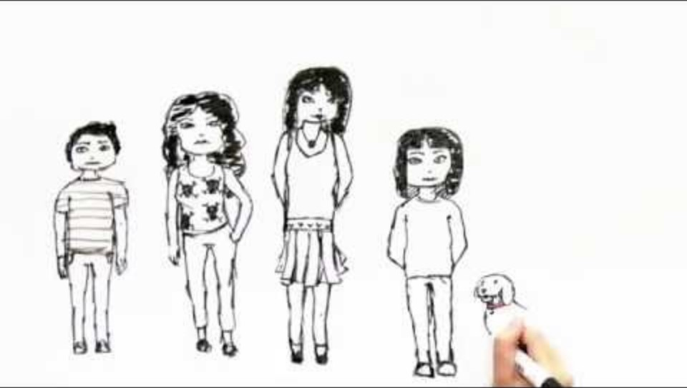
Michelle’s story
3
Notes:
https://youtu.be/0X8gsyk0Dv8?si=S5NdproPpilrTk91
This activity should take around 15-20mins.
Watch the video for the first two minutes, then pause (a good point is just after the narrator says, “I remember that they used to fight, and it was bad if they had been drinking beer.”).
In small groups, identify what information people have gathered, what issues and concerns are starting to be raised. E.g. ACES, domestic abuse
-----
Watch the next two and a half minutes of the video – 2-4.5 mins, then pause again (a good point is after the narrator says “When I did get to school I would often be late, hungry and wearing dirty clothes.”).
In your small groups think about:
What other issues and concerns do you now have.
Who should now be involved, what action would you take in school?
What support is required for everyone in the family?
What type of abuse may be going on here?
-----
Watch the remainder of the video, 4- 7mins.
The resolution.
Consider – what if the school did not take action to support Michelle, what are the possible outcomes for her and her family?
Further learning and reading:
https://safeguarding.network/content/safeguarding-resources/neglect
https://www.nspcc.org.uk/what-is-child-abuse/types-of-abuse/neglect/

Slide 22

BREAK
Notes:
We recommend 15 minutes.

Slide 23
Other potential harms/vulnerabilities include:
3
Bereavement/loss
Sharing nudes/sexual images
Bullying, cyberbullying
Children missing from education, home, care
Child sexual or criminal exploitation
Disability/SEND
Domestic and gender based sexual and relationship abuse
Faith abuse
Family member in prison
Young carers
Mental ill-health
Trafficking
Hate incidents/abuse
Upskirting
Gangs and serious violence
Child on child abuse, sexual harassment and sexual violence
Contextual safeguarding
Self-harm
Unexplained and/or persistent absence from education
Fabricated or induced illness
Modern slavery
Anti-social/criminal behaviour
Children in the court system
Returned from care
Private fostering
Homelessness
Honour based abuse, forced marriage, FGM, breast ironing
Substance misuse
Extremism/radicalisation
Notes:
As we can see there are multiple areas of potential harm and vulnerability. Information about these can be found in Part One of Keeping Children Safe in Education and Annex B.
Some specific areas to highlight are:
Serious violence – there is a duty in relation to this which is to co-operate with agencies such as the police, local government, youth offending teams, health and probation services, to work collaboratively, share data and information, and put in place plans to prevent and reduce serious violence within their local communities.
Prejudicial and discriminatory bullying and the additional vulnerabilities of LGBTQ+ children, along with the impact of misogynist / misandrist and other hate-based comments / actions.
Unexplained and/or persistent absence from education – these are growing issues, and it is important that we identify any children or young people who are in these categories as they are potentially at significantly higher risk.
More information on these areas can also be found on the Safeguarding Network website.

Slide 24


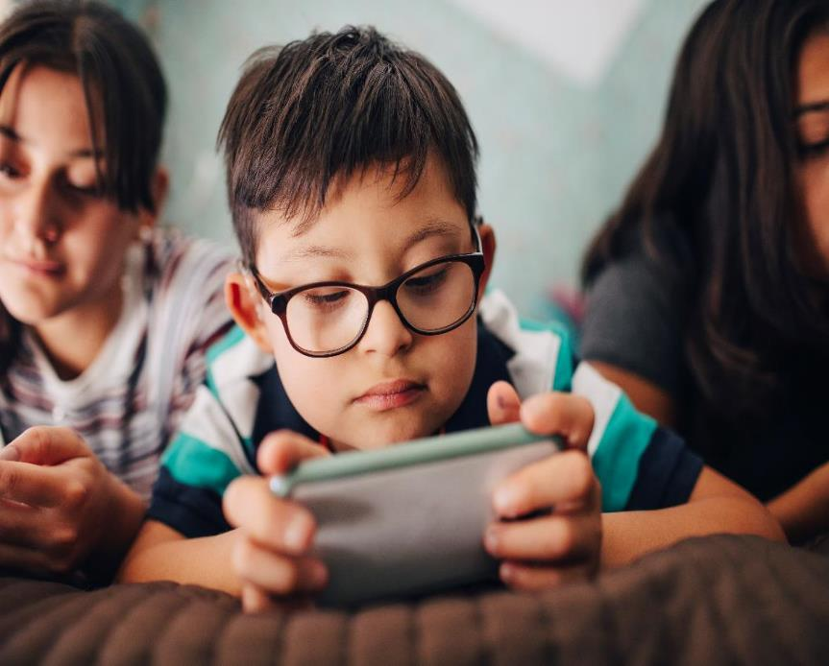


Online safety – what are the risks?
3
Notes:
We have seen that as well as experiencing harm/abuse/neglect within the family home, children can experience abuse outside of the family home in other contexts of their lives. Children may abuse other children, experience exploitation or experience abuse online as well as many other specific safeguarding risks.
With the role that technology plays in our lives on a daily basis, and the young age at which children now have access to devices, we need to ensure that we do not ignore the impact of children’s online experiences. Through online devices, children and young people can be accessed in places that were historically safe (for example bedrooms) and at all hours of day and night.
It can be easy to see online safety as a specific concern in itself, which it can be, however many forms of abuse can be perpetrated with technology and perpetuated through online spaces. In addition to experiencing abuse/exploitation, there can be other risks to children accessing online spaces.
What do you think might these include?

Slide 25
Risks associated with online space
3
Violent content
Pornographic content
AI / Deep fake child sexual abuse images and materials
Hateful content
Adverts and spam
Harassment
Grooming
Identity theft
Online bullying
Sharing nudes / semi nudes
Harmful content
Copyright infringement and piracy
Gambling
Social networking and gaming
Radicalisation
Notes:
It is important to highlight that technology is ever evolving and there are many benefits of accessing online spaces and technological devices for learning, fun, socialising and development. However, these spaces and devices can also be exploited, used for harm and misused/have unintended effects.
Our role is to ensure we are aware of the key issues with online spaces, provide an open and honest environment where we can explore children’s online presence and use of
technology without scaring or prohibiting appropriate use.
Filtering and monitoring systems are important, as is the way we interact with children through preventative education and through our partnership with parents and carers. How would you raise online concerns, and to whom?
The key message is that despite the use of technology, a safeguarding issue is a safeguarding issue. Do not be distracted by technology and think of it as something different – all concerns need to be addressed thoroughly and in line with safeguarding guidance and policy.
The online space is ever evolving. One example that is becoming more prevalent is deepfake technology. This is used to create images or videos of people doing or saying things which they did not do or say. The name comes from a combination of “deep learning”, which refers to the type of Artificial Intelligence (AI) tool used to create the material, and “fake”. Deepfakes are videos, picture or audio clips made with artificial intelligence to look real. They can be used for fun, or even for scientific research, but sometimes they're used to impersonate people like politicians or world leaders, in order to deliberately mislead people.
To create a deepfake, the tool is fed images or videos of the activity which the creator wants to portray, alongside images or videos of the person who will appear to perform the activity. The more data the AI is fed, the more realistic the deepfake will be. Deepfakes have garnered widespread attention for their potential use in creating child sexual abuse material, celebrity pornographic videos, revenge porn, fake news, hoaxes, bullying, and financial fraud. Child Sexual Abuse Material generated through Artificial Intelligence is referred to as AI CSAM.

Slide 26
Aims of this training
1
Understand what safeguarding is and your responsibility to fulfil your safeguarding responsibility
2
Be familiar with the key messages in the guidance and legislation
Know types of abuse, how to spot the signs and indicators , and how to respond
Understand how to report concerns about professional adults
5
Know how to receive a disclosure and record safeguarding concerns effectively
4
3
Notes:
We are now going to move on to consider what to do if the risks to children and young people come from the adults who are there to work with them (either employed or on a voluntary basis).

Slide 27
Allegations against staff
4
Do you understand every aspect of the staff code conduct?
Do you know what to do if:
  you think you’ve breached the code of conduct?
  you are concerned about another staff member’s behaviour but think it is a ‘low level concern’?
  you are concerned about another staff member’s behaviour and feel that it may meet the ‘threshold of harm’ criteria?
Notes:
We are all in positions of responsibility and people look to us daily to ensure that we provide the children and young people in our care the best support we can. With this responsibility comes expectations, and these are set out in our staff code of conduct. So, we need to challenge ourselves.
Do you understand how every aspect of the staff code conduct applies to you? If not, read it again and if necessary, ask for advice from the DSL as soon as possible
If you think you’ve done something that is not in line with the staff code of conduct and/or could be mis-interpreted, report the matter to the Headteacher/Principal (or equivalent) immediately.
We also know that there are some people who come into our line of work because it means they can access children and young people, and also individuals who may not have come into their role because of the access to children and young people, but whose views may change over time because of one reason or another. It is therefore important that we maintain an attitude of “It could happen here”. We will talk about low level concerns in a minute, however ,if you are concerned about another staff member’s behaviour but it does not appear to meet the threshold of harm, we need to follow the low-level concerns policy and report it to [you will need to tell the group who to report it to as this is different across different settings].
If you are concerned about another staff member’s behaviour and feel that it may meet the ‘threshold of harm’ criteria which we will also look at in a minute, follow the managing allegations policy and report to the Headteacher/ Principal (or equivalent) unless it is about them, in which case report to your Chair of governors/trustees or equivalent [tell staff who this is and how to contact them].
There are times when it might it be difficult to decide whether to report something, but it is better to flag it up than not.
[Presenter note: This is a useful conversation to have – dealing with low level concerns and allegations is challenging. Exploring some of the issues and difficulties is a healthy part of developing your school safeguarding culture. You might choose at another time to run our abuse by people in professional role presentation and scenarios (https://safeguarding.network/allegations).]

Slide 28
What is a low-level concern?
4
A low-level concern is a concern about professional conduct that breaches the Staff Behaviour Policy but does not meet the threshold of harm.
All low-level concerns must be reported to the appropriate person in your setting, as set out in your low-level concerns procedure.
These will all be recorded, and appropriate action taken.
If you think that there is a continuing risk, escalate your concerns in line with your escalation policy.
Keeping Children Safe in Education
Some examples are given in KCSiE, what others can you think of?
Notes:
The term ‘low-level’ concern does not mean that it is insignificant. A low-level concern is any concern, no matter how small, and even if no more than causing a sense of unease or a ‘nagging doubt’, that an adult working in or on behalf of our setting may have acted in a way that is inconsistent with the staff code of conduct and includes inappropriate conduct outside of work.
Examples of such behaviour could include, but are not limited to:
being over friendly with children
having favourites
taking photographs of children on their mobile phone, contrary to our policy
communicating with children over social media through personal accounts
engaging with a child on a one-to-one basis in a secluded area or behind a closed door, or
humiliating children.
None of these behaviours may meet the harm threshold in their own right, but they are all inconsistent with the requirements of the staff code of conduct. It should be acknowledged that such behaviour can exist on a wide spectrum, from the inadvertent or thoughtless, or behaviour that may look to be inappropriate, but might not be in specific circumstances, through to that which is ultimately intended to enable abuse.
Research has shown that where people in positions of trust abuse children in their care, leading up to this there have often been a number of situations where they have been testing the boundaries and looking to see what the response of those around them will be.
Low-level concerns may arise in several ways and from a number of sources. For example, it may include suspicion, complaint, or a disclosure made by a child, parent or other adult within or outside of the organisation, or as a result of vetting checks undertaken.
Low level concerns must be reported to the person in your setting which has been agreed to be the most appropriate person. This might be the DSL or the Head, but this must be made clear in the setting’s staff behaviour policy and all staff must know the procedures for reporting low level concerns. If concerns are not reported to the head in the first instance, it is important that the Head is updated on these concerns.
[You will be able to advise on the arrangements in your setting.]
For concerns about the Head, these must be reported to the Governors/trustees.
The key message is – if you have concerns over a professional adult, you must report them (remind staff that if your setting receives an allegation relating to an incident at an out of school setting that was using your premises, your policies and procedures should be followed as well).

Slide 29
Threshold of harm
4
The individual has:
behaved in a way that has harmed a child, or may have harmed a child; and / or
possibly committed a criminal offence against or related to a child; and / or
behaved towards a child or children in a way that indicates he or she may pose a risk of harm to children; and / or
behaved or may have behaved in a way that indicates they may not be suitable to work with children.
Notes:
Some concerns about colleagues, or actions that they undertake are significant and these are then considered against the threshold of harm. The concept of a professional harming a child was formalised nationally following the deaths of Holly Wells and Jessica Chapman. Currently there are 4 criteria and if any one of these are met then the threshold of harm has been met and there are more formal processes to be followed. The criteria are outlined on the screen.
It is important that if you suspect or are told that a professional is acting in a way that is covered by any of these four criteria, you report your concerns to the Head or Principal, (unless the allegation is about the Head/Principal in which case you need to report to the chair (or designated person for such allegations) of your settings governance body/structure)) [Presenter note: You can advise on the arrangements in your setting. You may wish to add local information at this point, including whether this is included in the safeguarding policy, staff behaviour policy and any whistleblowing/managing allegations policy. Remind staff that if your setting receives an allegation relating to an incident at an out of school setting that was using your premises, your policies and procedures should be followed as well, which may include informing the Local Authority.]

Slide 30

What would you do?
4
Notes:
Ensure the participants have access to the scenarios sheet. Four to read, discuss and feedback.
Scenario 1: B
Scenario 2: C
Scenario 3: A
Scenario 4: C - but all three!

Slide 31
Aims of this training
1
Understand what safeguarding is and your responsibility to fulfil your safeguarding responsibility
2
Be familiar with the key messages in the guidance and legislation
Know types of abuse, how to spot the signs and indicators , and how to respond
Understand how to report concerns about professional adults
5
Know how to receive a disclosure and record safeguarding concerns effectively
4
3
Notes:
Finally we are going to consider how we respond to individual children and young people.

Slide 32
Responding
5
All staff should be aware that children may not feel ready or know how to tell someone that they are being abused, exploited, or neglected,
and / or they may not recognise their experiences as harmful.
Barriers should not prevent staff from having a professional curiosity and speaking to the DSL if they have concerns about a child.
It is also important that staff determine how best to build trusted relationships with children and young people which facilitate communication.
Notes:
It is important to acknowledge that children and young people may often chose to tell you what is happening to them at unexpected times and in unexpected ways – various kinds of behaviour can be a form of them telling you they are not happy about something. Therefore, it is imperative that you all maintain an open and calm approach in all practice to support in facilitating communication through trusted relationships.
Information should be shared with the Safeguarding team if low level issue; DSL or Deputy immediately if risk of significant harm; (Head/Principal if allegation against staff) etc. [Presenter note: Use this as an opportunity to direct staff to your settings safeguarding policy and procedure.]
You should never worry about whether or not to share concerns – better to share and find out nothing was wrong, than not to share and not to protect a child. Abuse is not just about inflicting harm, it is also about “failing to act to prevent harm”. (KCSiE)

Slide 33



5
Hear me
See me
Understand my life
Notes:
Click on each picture for further information slides, clicking on purple arrows to get back to this slide each time.
As we have seen, children may not be ready or able to disclose abuse verbally, and therefore we need to think carefully about what signs and indicators there are, keep an open mind and employ professional curiosity (asking “what of” in order to create an environment where we can support children who are experiencing abuse or harm in order to intervene.
Remember, safeguarding is not just child protection and includes early help - the earlier a problem is identified then the better the outcome often for the child. As identified in Keeping Children Safe in Education, there are some specific circumstances where children may need early help. These include if a child:
is disabled or has certain health conditions and has specific additional needs;
has special educational needs (whether or not they have a statutory Education, Health and Care Plan);
has a mental health need;
is a young carer;
is showing signs of being drawn in to anti-social or criminal behaviour, including gang involvement and association with organised crime groups or county lines;
is frequently missing or going missing from care or from home;
is at risk of modern slavery, trafficking, sexual or criminal exploitation;
is at risk of being radicalised or exploited;
has a family member in prison, or is affected by parental offending;
is in a family circumstance presenting challenges for the child, such as drug and alcohol misuse, adult mental health issues and domestic abuse;
is misusing alcohol and other drugs themselves;
has returned home to their family from care;
is at risk of so-called ‘honour’-based abuse such as Female Genital Mutilation or Forced Marriage;
is a privately fostered child; or
is persistently absent from education, including persistent absences for part of the school day.

Slide 34

Recording your concerns in writing
5
Record keeping is an important part of safeguarding. Effective records can help identify patterns and concerns which might be missed if we didn’t have systems in place.
Every piece of information might be part of a bigger picture.
How might your records be used in safeguarding?
Notes:
Ask the participants:
How might the records we keep be used? Who might see them?
Ensure answers include referrals to other agencies, courts (family/criminal), parents themselves, children themselves, especially in future through subject access requests, child protection conferences / reports, police information, child safeguarding practice reviews, etc.
It is important that we know how to keep accurate and effective records which are free from emotive language and based on facts. All records should be made in line with your setting’s record keeping guidance and systems.
The records we keep may be shared outside of your setting. Normally, this decision will be made by a DSL in terms of who needs to have this information and for what reasons. All staff should be aware of the need for confidentiality, but also reminded that fears of sharing information should not stand in the way of safeguarding children.
We also need to remember that sometimes we will be asked about why we acted the way that we did – this may be months or years later and therefore your recording is important as the source of information.

Slide 35
5
Sophie D’s dad came to reception, he was kicking off because yesterday she was bullied online by older boys who were threatening to send nude photos of her to everyone in the school, and he wanted to see her form teacher. Mr Smith wasn’t available, so I said I’d meet with him. He said that Sophie told him that she had reported this, but nothing had been done and he wanted it sorted. He wanted the contact details for these boy’s parents. Sophie’s dad said that this morning he had struggled to get her to school because of the threats that had been made online. He told her to show me the messages. I read some of the messages Sophie had put on there and she was as bad as the others posting on there. I told Dad that they needed to talk to the DSL.
DS, 8th March
Notes:
Ask the participants to read through the information on the slide. What are their thoughts on this as a safeguarding record? Is it effective? How could it be improved? What does it tell us?

Slide 36
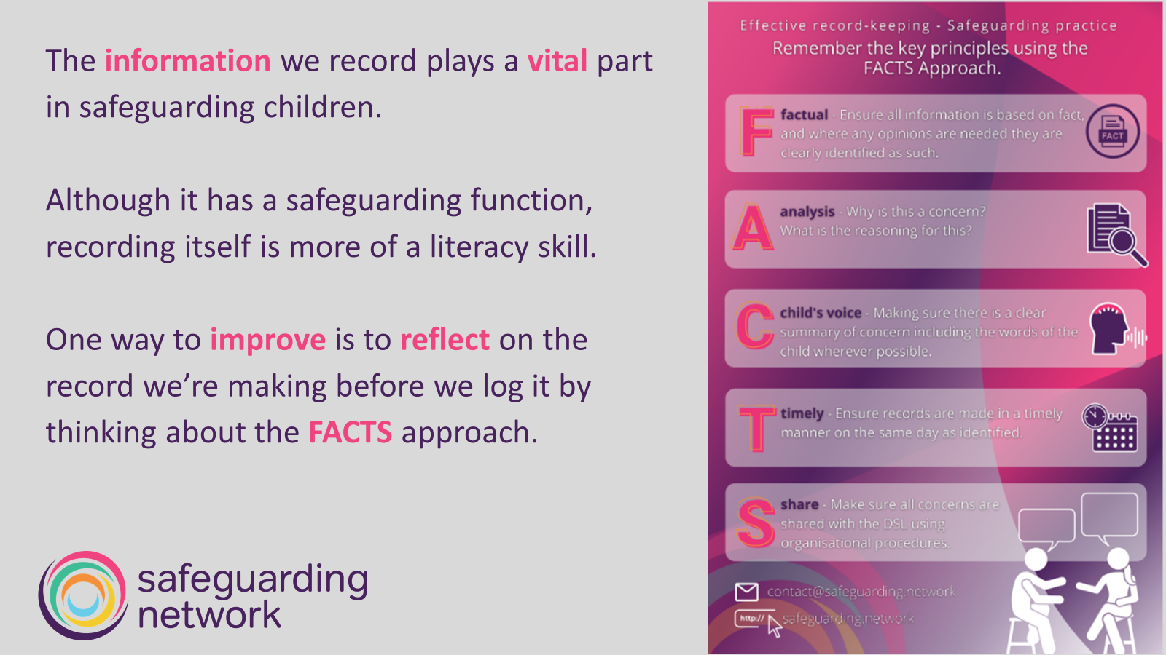
5
Notes:
In summary, where you have concerns about a child, these are shared with the DSL immediately. Recording is an important and crucial part of this, however sometimes an immediate verbal report is needed which can then be followed up with the written record. This would apply where a child is deemed to be at risk of significant harm and immediate action is required to protect them. Make sure that the record is factual, provides an analysis of why this is a concern, includes the child’s voice, is timely and shared appropriately. It should also include:
Full name, date of birth and year group of the child/young person.
Full name and job title of person writing the record.
Date and time of writing the record and when an incident and/or concern happened / began.
Details of the incident/concerns, what gave rise to the latter, and any discussions had and with whom.
All actions taken, and outcomes.
The extent and nature of any involvement by other professionals (including colleagues)/children/adults, and their full details (NOT initials). Information can be redacted if necessary when sharing.
Date and authors signature at the end of the record.

Slide 37
5
At 9.45 am, as I was approaching the reception area, Mr Dudley arrived with his daughter, Sophie Dudley. He was upset and angry. He told me that Sophie had come home yesterday crying saying that she had received online threats from older students who stated that nude photos of her would be shared around the school. Mr Dudley also told me that Sophie reported this to a member of school staff, but it hadn’t been dealt with. Last night there were several more messages posted online regarding this, and Sophie had got upset and retaliated, sending messages back in self-defence. She had not wanted to come to school today however, he managed to persuade her so that it could get sorted.
1/2
Notes:
Ask the participants to read through this entry (over two slides). Is this one better? Why? What has been changed? What difference would this make to Sophie?
(If you are using a recording system that does not prompt users to enter the full name, date of birth and year group etc. of the child/young person concerned, remind staff that these should be included too).

Slide 38
5
Mr Dudley told Sophie James to show me the messages on her phone. Mr Dudley told me that there were only written messages on there, no photographs or any inappropriate material. I saw a message trail that started yesterday involving several Year 10 students and the responses from Sophie.
I told Mr Dudley that we took things like this very seriously, and that the DSL Mrs Green, would need to be informed. I explained that, although I could do this, it would be better if Sophie and Mr Dudley did it in person. I then escorted them to Mrs Green’s office, and she took over from there.
David Smith, Head of Year 8, 10.30 am, 8th March 2024
Notes:
Ask the participants to read through this entry. Is this one better? Why? What has been changed? What difference would this make to Sophie?
(If you are using a recording system that does not prompt users to enter the full name, date of birth and year group etc. of the child/young person concerned, remind staff that these should be included too).

Slide 39
Action points
Summary
Time
Take time to read and make sure you understand the guidance and your setting’s policies
Create
Create a culture where children can speak out or share their concerns with staff
Know
Know the signs and indicators of abuse / neglect, including online concerns
Report and record
Report and record your concerns, including concerns about professional adults
Commit
Commit to and engage in continued professional development
Notes:
[Presenter note: This training represents a whistlestop tour of safeguarding. For full and comprehensive training staff would need to attend much longer sessions, over days and weeks to fully explore all aspects in detail, which few settings have time or budget for. This is designed to be an overview, but not a replacement for ongoing continuing professional development in safeguarding areas and reading the guidance.
This is also an opportunity for thoughts and reflections from participants on the training.]

Slide 40

Notes:
Ensure the participants have access to the Quiz Sheet. Allow time for discussion, then explain to participants that questions 1-5 will be answered as you go through the course. Ask them to check their answers as they go along. Give answers for questions 6-9 (see below for pointers, plus refer to your setting’s policies.
Name and describe the four main categories of child abuse and give at least four possible indicators for each (see the handout for full definitions).
If a child/young person tells you they are being harmed, outline all the steps you would take.
How can you ensure that information about children/young people/families/staff is kept and shared securely?
Outline all the steps you should take if a child/young person makes an allegation against, and/or if you have concerns about, a member of staff.
If you want to take or use images of pupils, students or staff, who do you need to ask consent from? Who else, if anyone, do you need to check with?
When can you allow learners access to your personal social media accounts? What measures should you take to maintain professional boundaries?
What do you need to consider when working on your own with a learner?
What do you need to think about when considering the appropriateness of physical contact with a learner?
How can you be a positive role model for your learners? Give examples.
Pointers in relation to questions 6-9:
Most staff may answer ‘never’ in terms of learner access. Generally speaking, in a professional context, this is accurate. However, need to expand to discuss when learners are relatives… – e.g. if your child who attends the school you work in can access your personal account, how many of their friends can as well? What safeguards are in place? Also consider, how personal is social media? What you post may affect your professional life etc.
Need to consider safety of the child and potential for allegation against the member of staff – where are you – how isolated is the area, can you be overseen? Who knows you’re there and why Child/young person’s feelings, balancing privacy versus safety etc.
Need to consider wishes and feelings of child/young person, appropriateness/reason for physical contact, gender issues, religious constraints etc. Examples of when may be appropriate: administering First Aid, certain teaching situations like hand placement on a violin, appropriate physical restraint, dealing with distress etc.
Examples include behave in a respectful manner towards other staff, pupils/students and their families, do not ridicule, bully, coerce others, do not allow ridicule, bullying etc. to go unchallenged – ‘standing by’ is collusive, be consistent, apologise when you get it wrong.

Slide 41
Questions?
Keep learning …
For more information visit:
https://safeguarding.network/
Contact: 01803 862 336

Slide 42
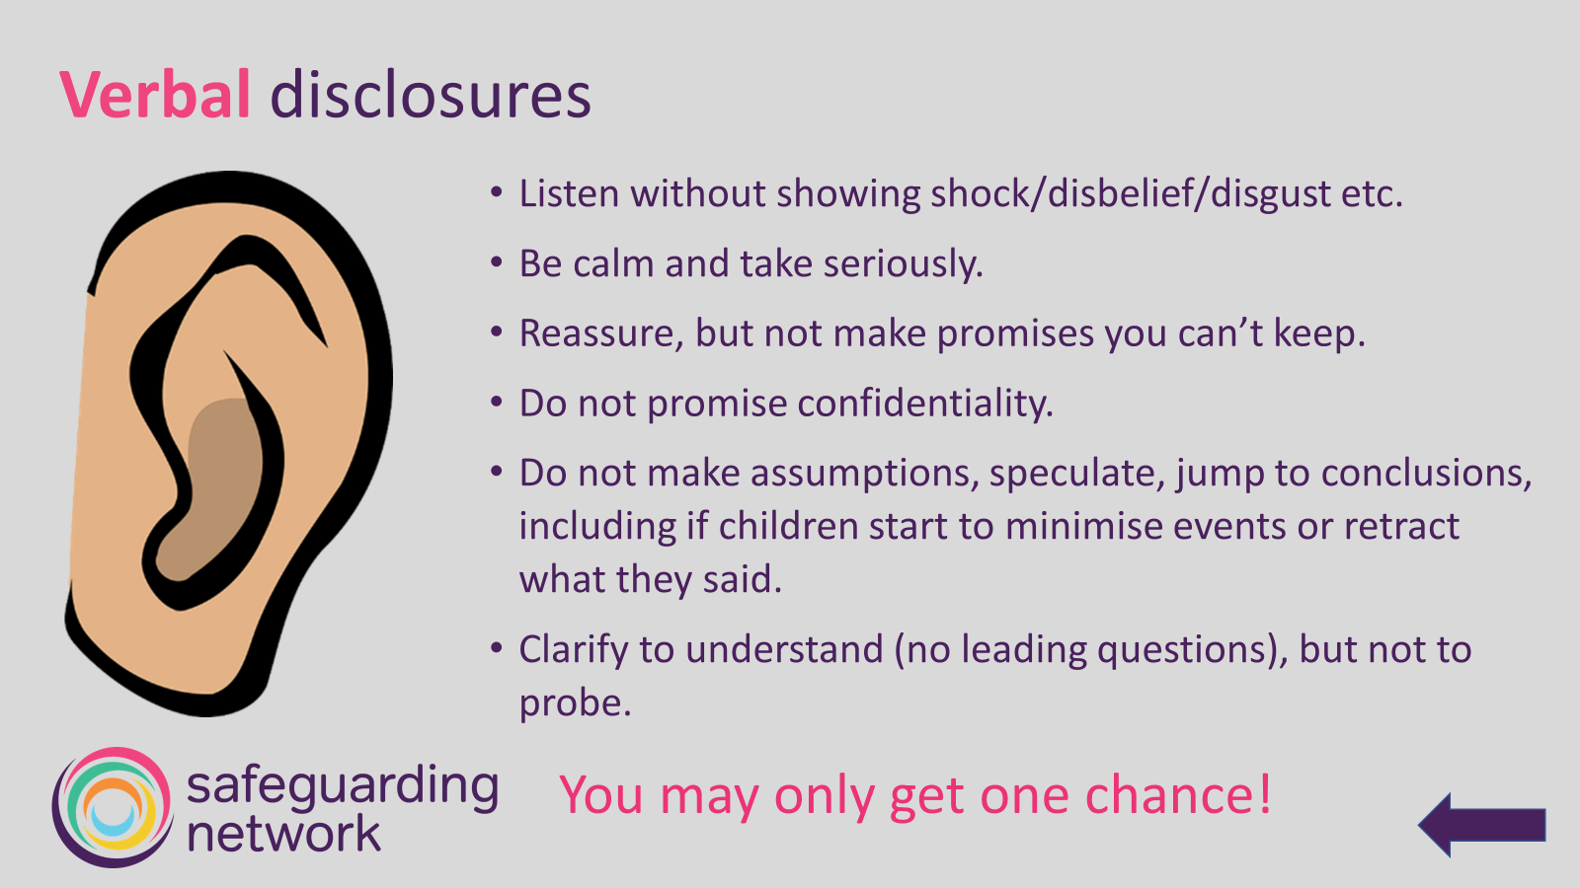

Slide 43
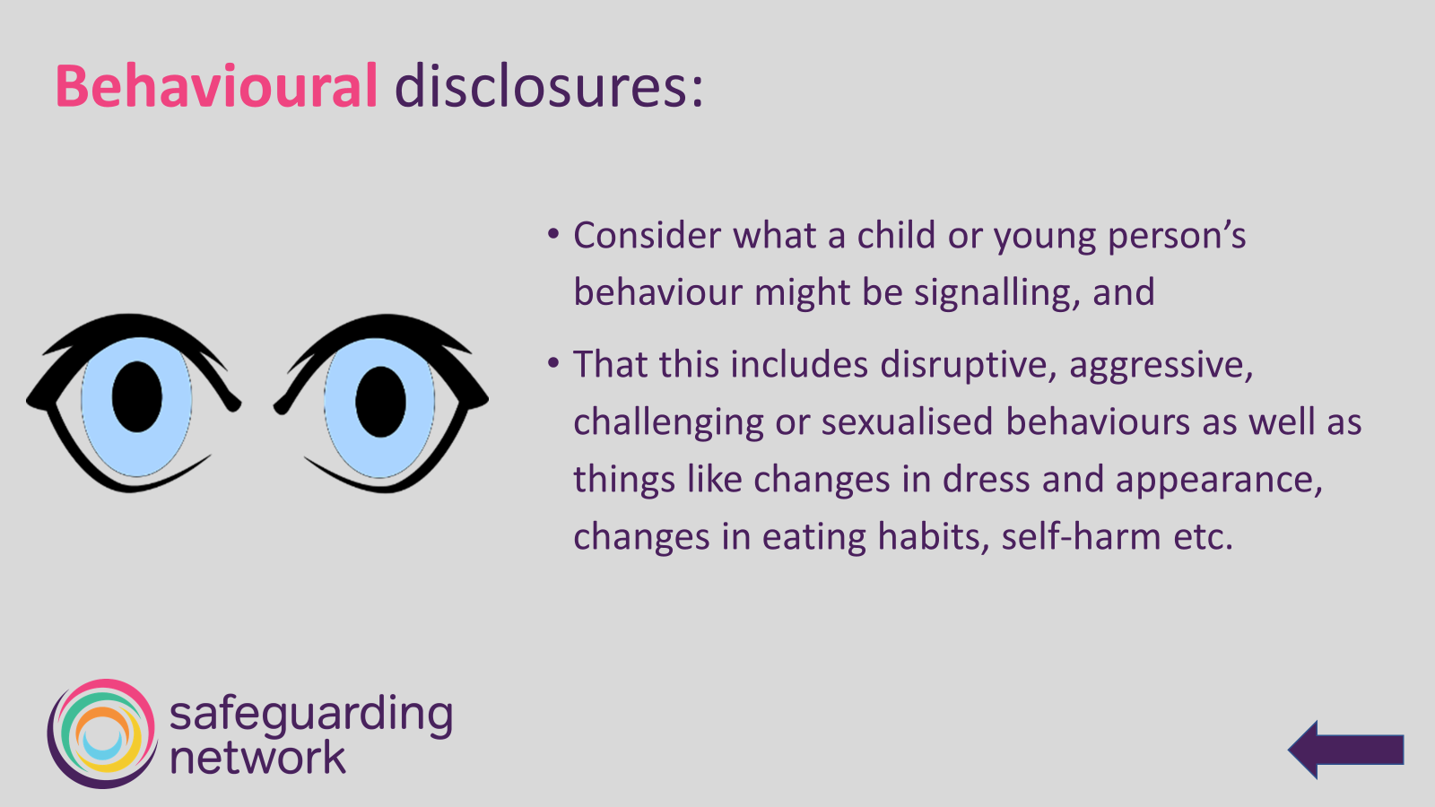

Slide 44
